Slide 1

Tea House
Name: Lau Po Hang
ID: 12371039

Slide 2
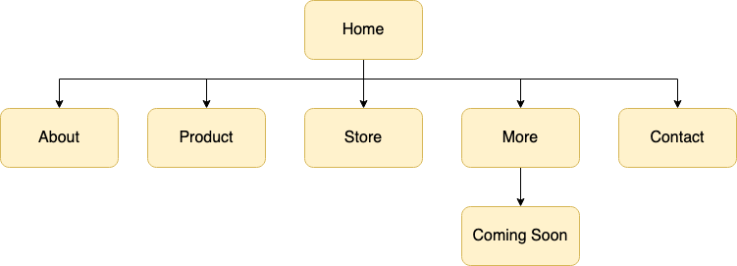
Site Map

